Slide 1
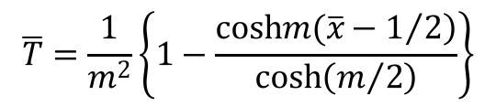
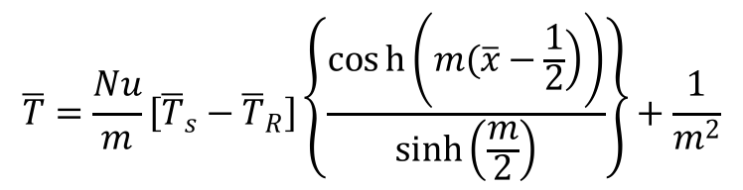
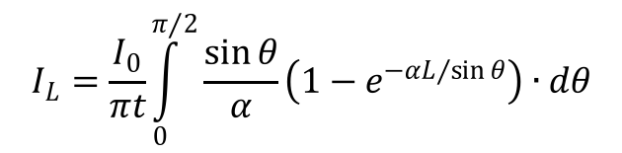
Closed Form Solutions
$$I_{L}=\frac{I_{0}}{πt}\int_{0}^{π/2}{\frac{\sin{θ}}{α}\left(1−e^{−αL/{\sin{θ}}}\right)∙dθ}$$
Direct Radiation
Temperature distribution for Constant Temperature B.C.
$$\overline{T}=\frac{1}{m^{2}}\left\{1−\frac{\cosh\left.m(\overline{x}−1/2\right)}{\cosh\left(m/2\right)}\right\}$$
$$\overline{T}=\frac{Nu}{m}\left[{\overline{T}}_{s}−{\overline{T}}_{R}\right]\left\{\frac{cosh\left(\left.m(\overline{x}−\frac{1}{2}\right)\right)}{\sinh\left(\frac{m}{2}\right)}\right\}+\frac{1}{m^{2}}$$
Temperature distribution for Constant Heat Flux B.C.

Slide 2
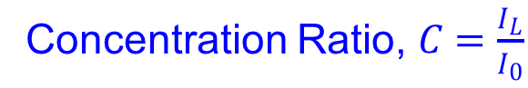



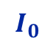
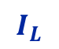
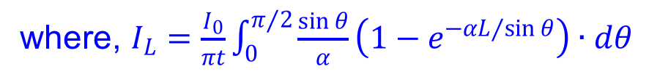
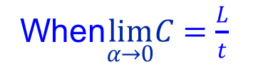
Previous Results
$$I_{0}$$
Concentration Ratio, $C=\frac{I_{L}}{I_{0}}$
$$w$$
where, $I_{L}=\frac{I_{0}}{πt}\int_{0}^{π/2}{\frac{\sin{θ}}{α}\left(1−e^{−αL/{\sin{θ}}}\right)∙dθ}$
$$L$$
When$\lim_{α→0}C=\frac{L}{t}$
$$t$$
$$I_{L}$$
Notes:
Increase font sizes of the text
Add red limiting line

Slide 3
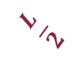
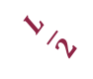
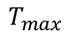
Previous Results
$$T_{max}$$
$$\frac{L}{2}$$
$$\frac{L}{2}$$
Notes:
Request for a smart monitor
Think about how can the handouts be distributed
Borrow a touchscreen monitors and write using the e-pen

Slide 4


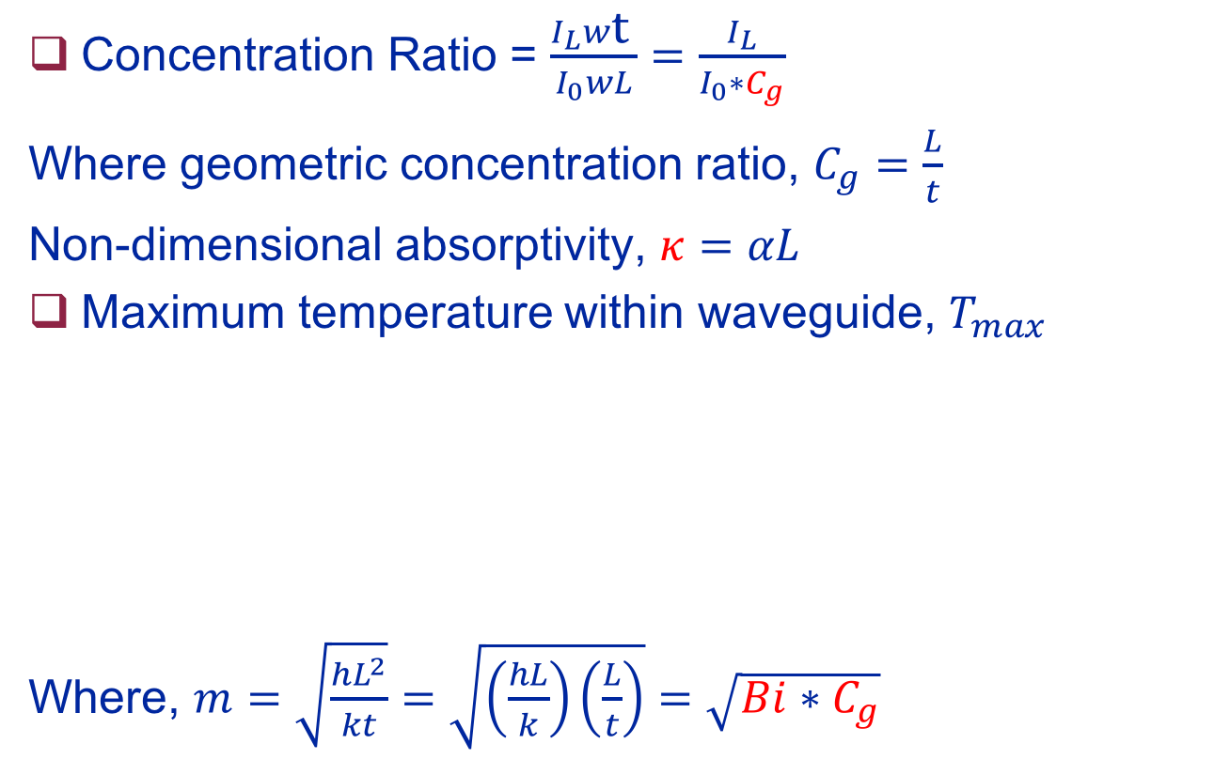
Variables of Interest
Concentration Ratio = $\frac{I_{L}w\text{t} }{I_{0}wL}=\frac{I_{L}}{I_{0}∗C_{g}}$
Where geometric concentration ratio, $C_{g}=\frac{L}{t}$
Non-dimensional absorptivity, $κ=αL$
Maximum temperature within waveguide, $T_{max}$
Where, $m=\sqrt{\frac{hL^{2}}{kt}}=\sqrt{\left(\frac{hL}{k}\right)\left(\frac{L}{t}\right)}=\sqrt{Bi∗C_{g}}$
$$\overline{T_{max}}=\frac{1}{m^{2}}\left\{1−\frac{1}{\cosh\left(m/2\right)}\right\}$$
$$\overline{T_{max}}=\frac{Nu}{m}\left[{\overline{T}}_{s}−{\overline{T}}_{R}\right]\left\{\frac{1}{\sinh\left(\frac{m}{2}\right)}\right\}+\frac{1}{m^{2}}$$

Slide 5

Effect of $κ$ and $C_{g}$

Slide 6

Effect of Bi and $C_{g}$
Notes:
Think of a chart similar to heisler chart

